Slide 1


AWS Microservices
Udayakumar Mathivanan
Cloud Solution Architect

Slide 2
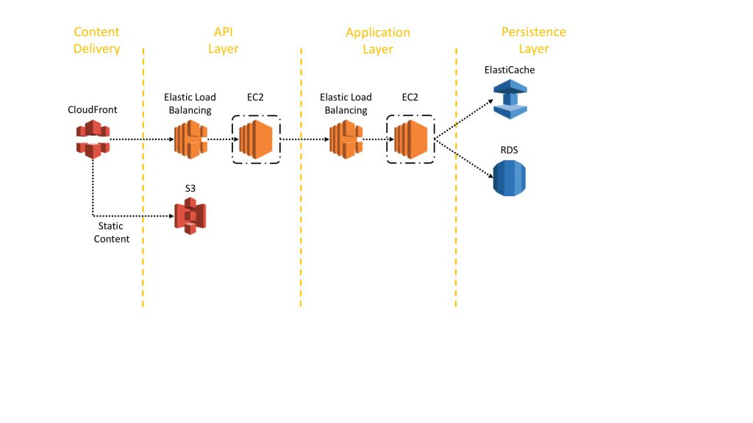
AWS Microservices Architecture

Slide 3
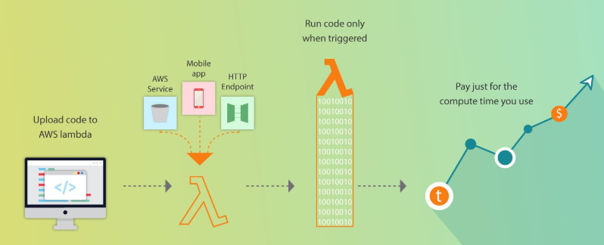
AWS Serverless Architecture

Slide 4
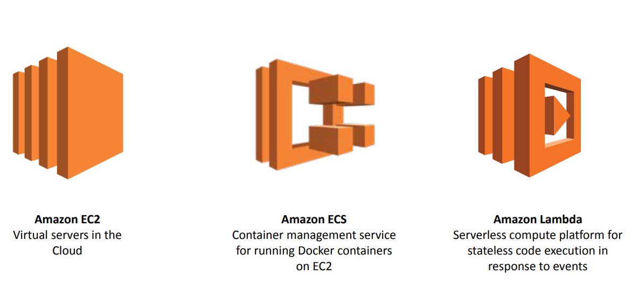
AWS Compute Offerings

Slide 5
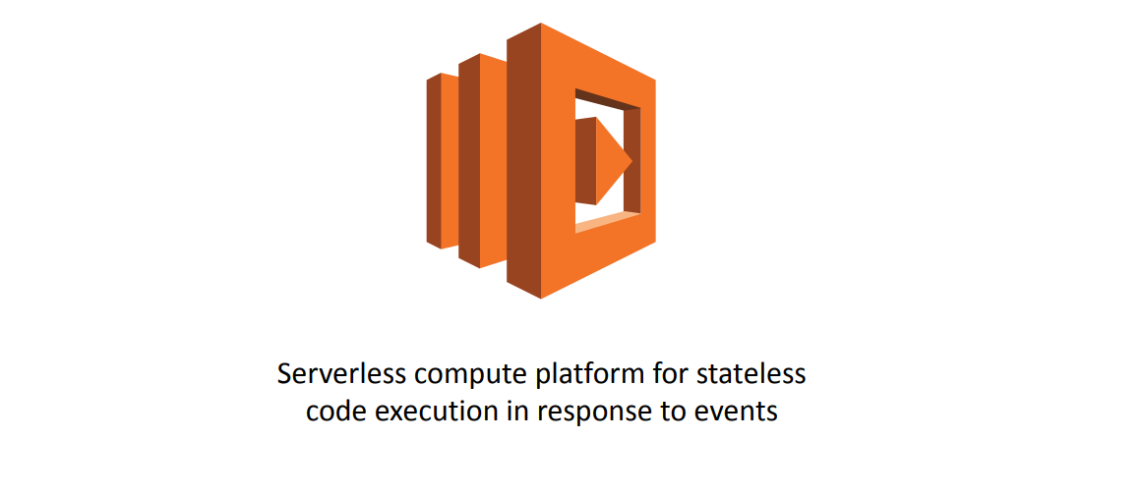
AWS Lambda

Slide 6
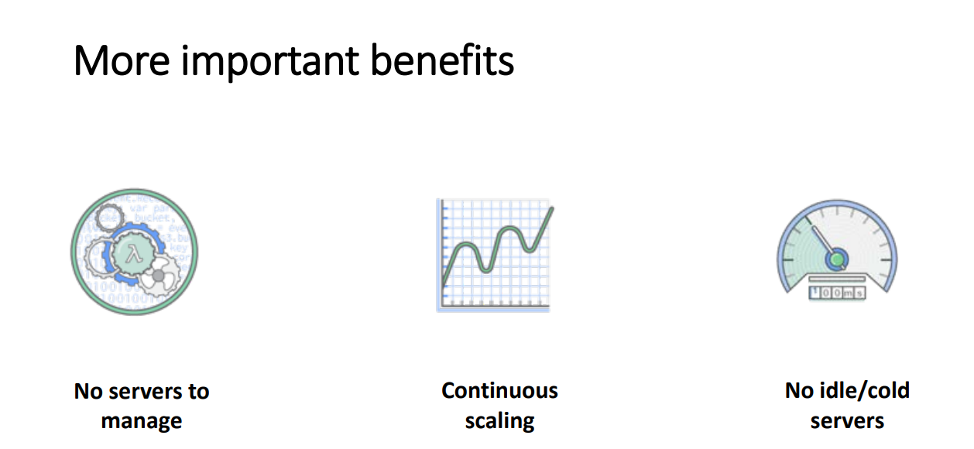
AWS Lambda

Slide 7
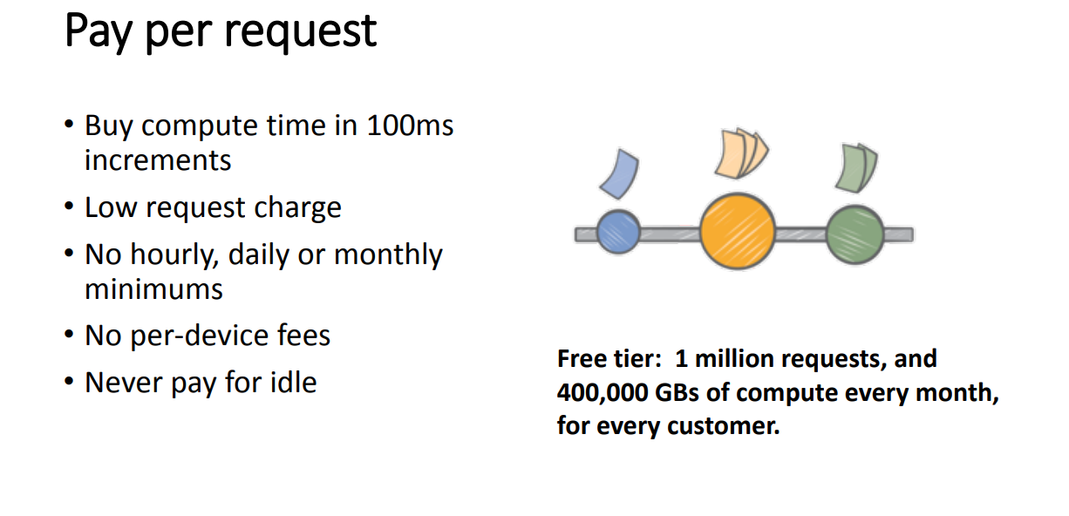
AWS Lambda

Slide 8
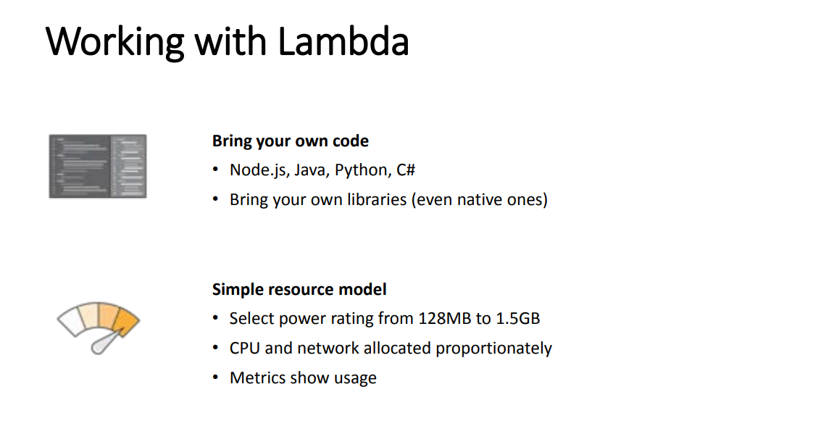
AWS Lambda

Slide 9
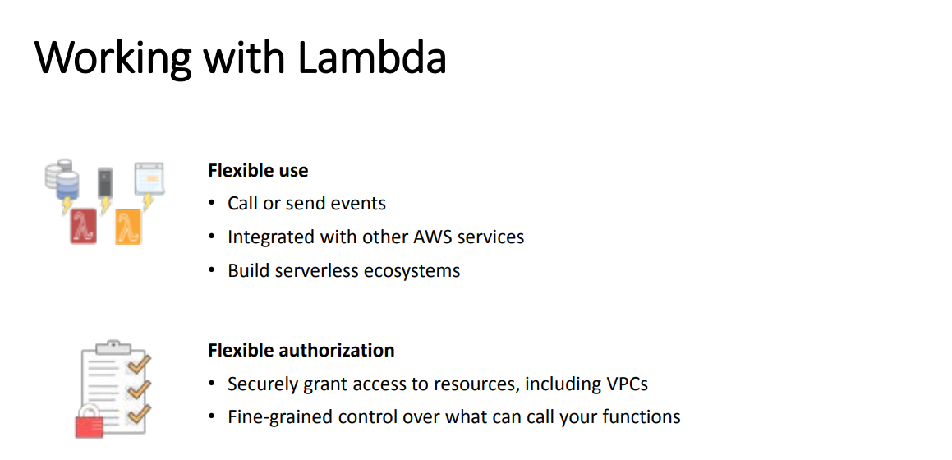
AWS Lambda

Slide 10
Blue/Green Deployment
When an application is developed and deployed to an AWS Elastic Beanstalk environment, having two separate, but identical, environments—blue and green—increases availability and reduces risk.
the blue environment is the production environment that normally handles live traffic. The CI/CD pipeline architecture creates a clone (green) of the live Elastic Beanstalk environment (blue). The pipeline then swaps the URLs between the two environments.
While CodePipeline deploys application code to the original environment—and testing and maintenance take place—the temporary clone environment handles the live traffic. Once deployment to the blue environment is successful, and code review and code testing are done, the pipeline again swaps the URLs between the green and blue environments. The blue environment starts serving the live traffic again, and the pipeline terminates the green environment.

Slide 11
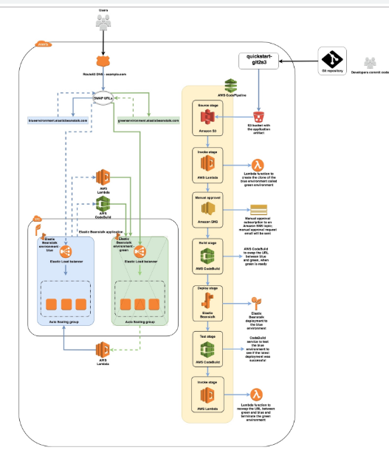
Blue/Green Deployment

Slide 12
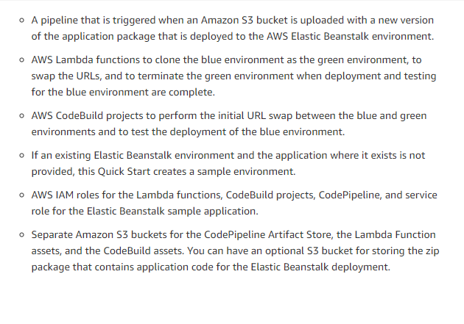
Blue/Green Deployment

Slide 13
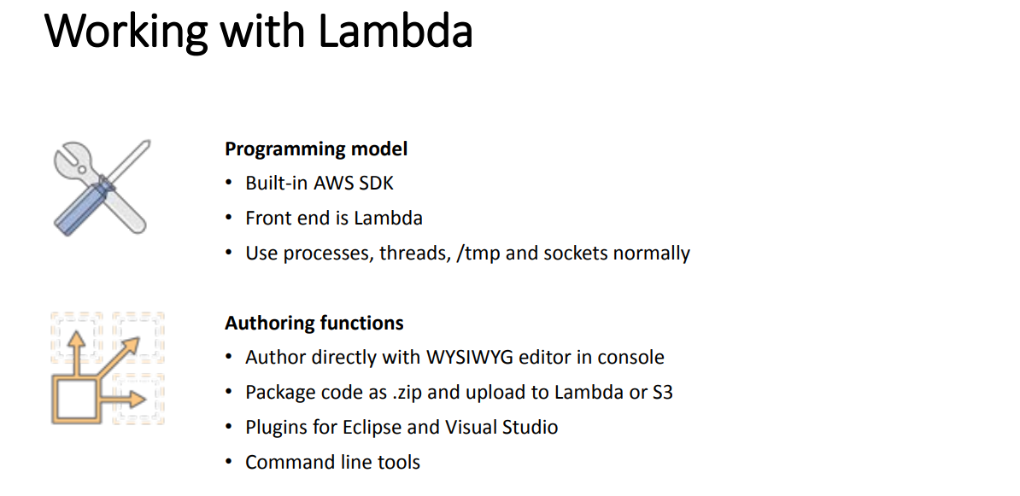
AWS Lambda

Slide 14
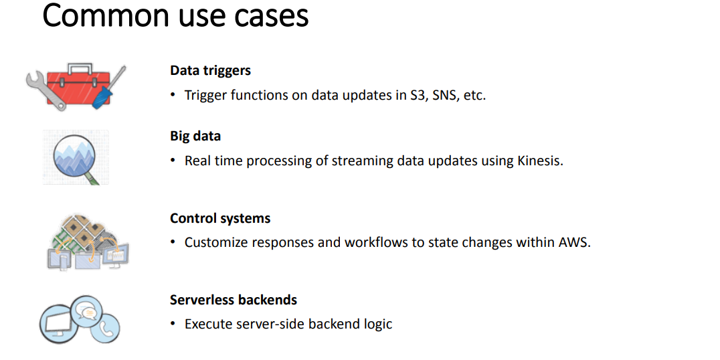
AWS Lambda

Slide 15
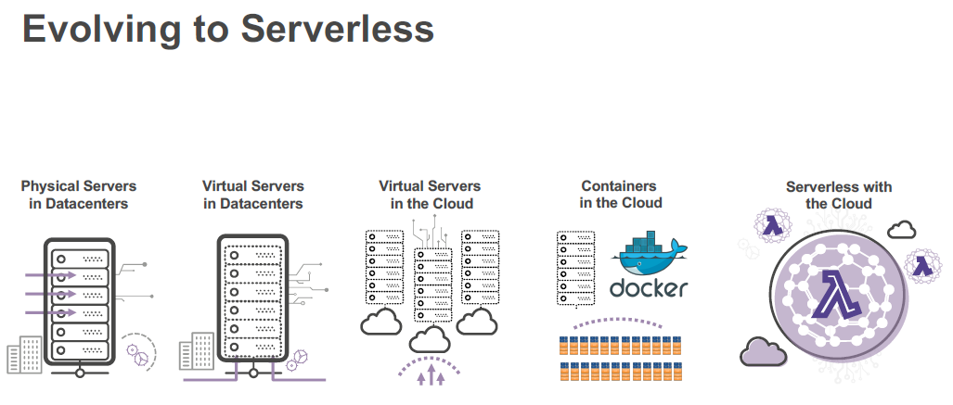
AWS Lambda

Slide 16
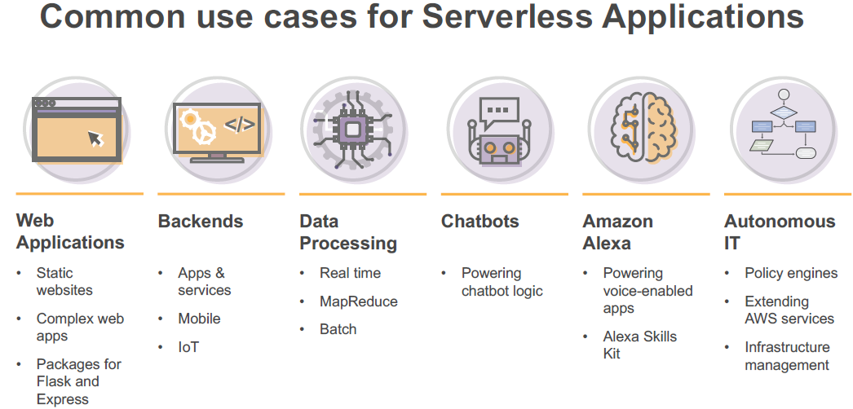
AWS Lambda

Slide 17
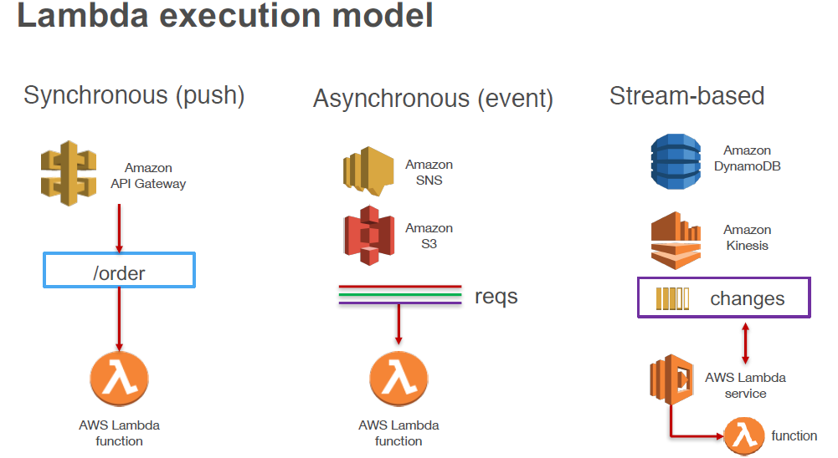
AWS Lambda

Slide 18
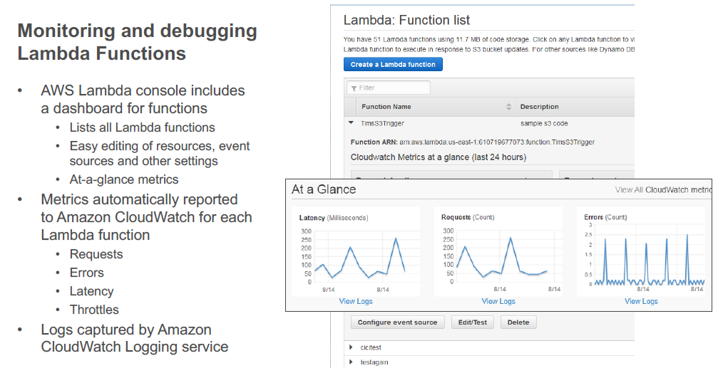
AWS Lambda

Slide 19
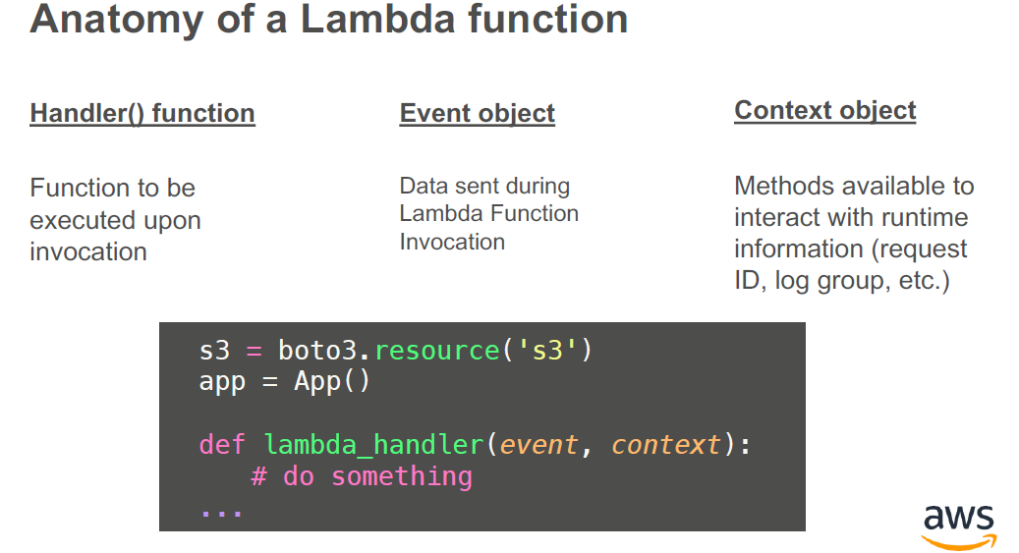
AWS Lambda

Slide 20
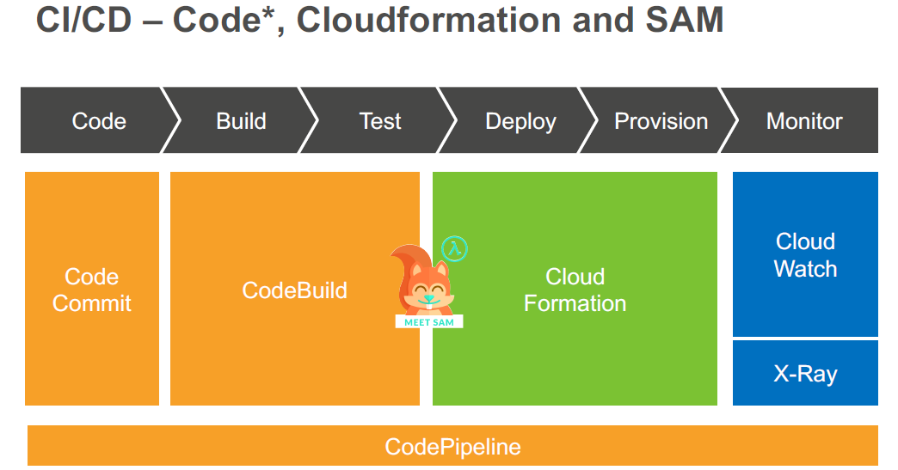
AWS Lambda

Slide 21
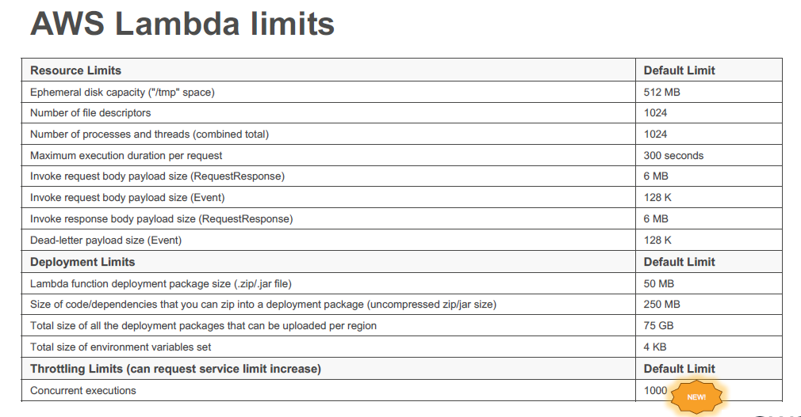
AWS Lambda

Slide 22
AWS Lambda
Lets Build a Hello World Lambda

Slide 23
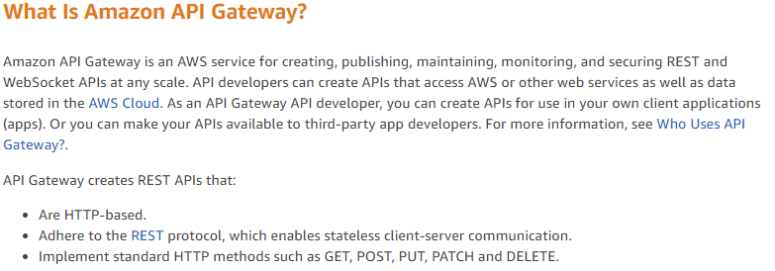
AWS API Gateway

Slide 24
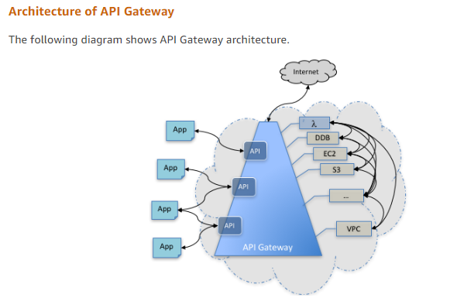
AWS API Gateway

Slide 25
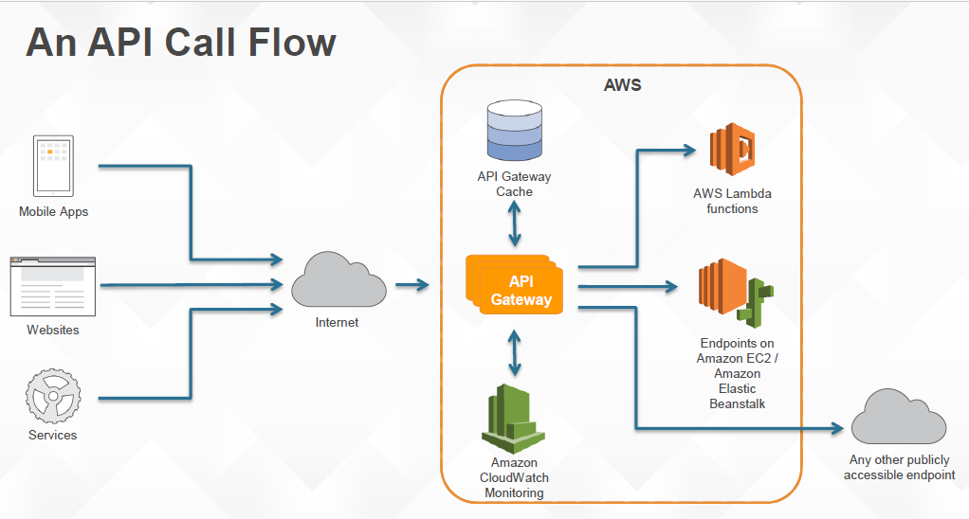
AWS API Gateway

Slide 26
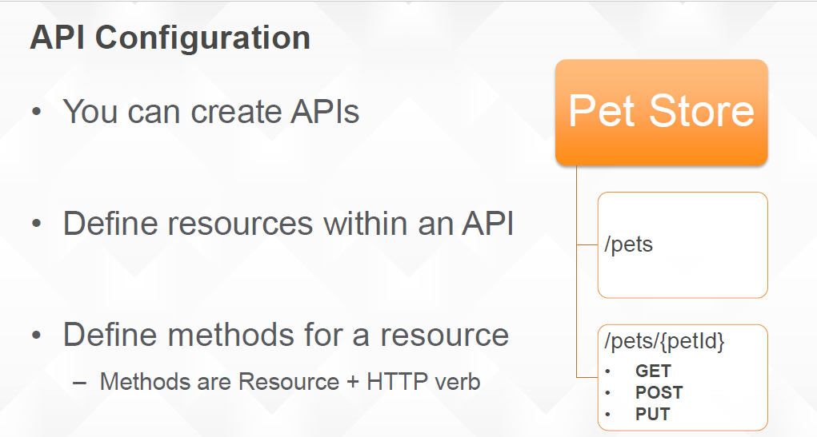
AWS API Gateway

Slide 27
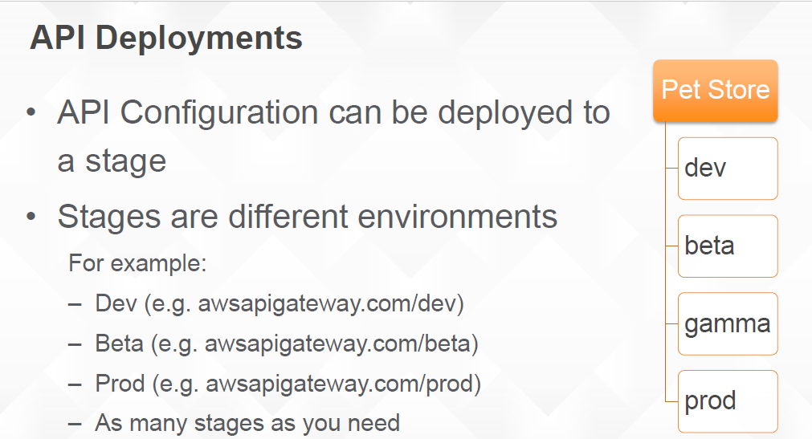
AWS API Gateway

Slide 28
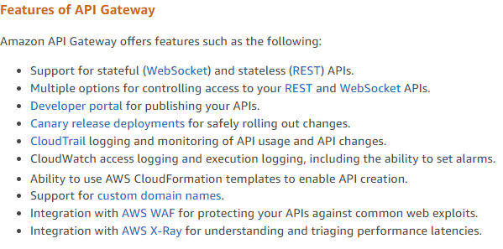
AWS API Gateway

Slide 29
Accessing API Gateway
AWS Management Console
AWS SDKS
API Gateway v1 and V2 Apis
AWS Command Line Interface
AWS Tools for Windows Powershell

Slide 30
Accessing API Gateway
Lets Build a Hello World API

Slide 31
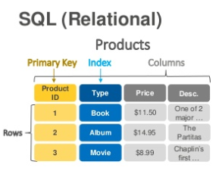
DynamoDB

Slide 32
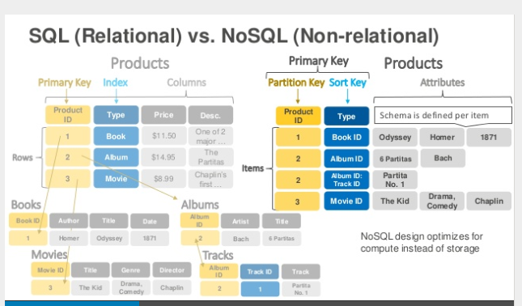
DynamoDB

Slide 33
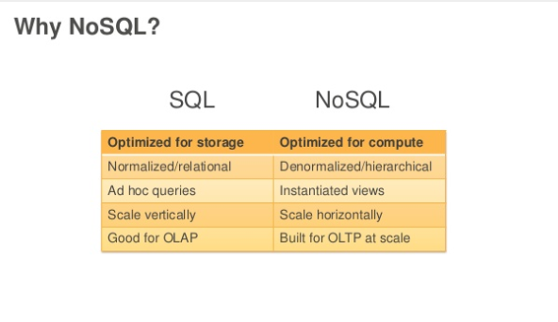
DynamoDB

Slide 34
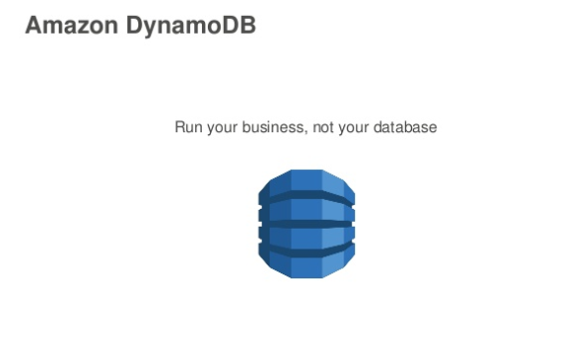
DynamoDB

Slide 35
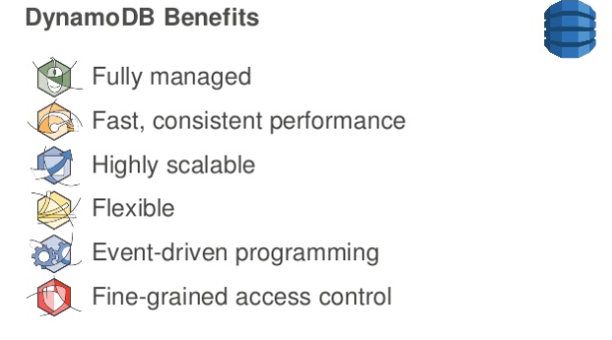
DynamoDB

Slide 36
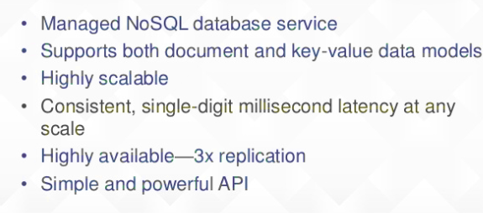
DynamoDB

Slide 37
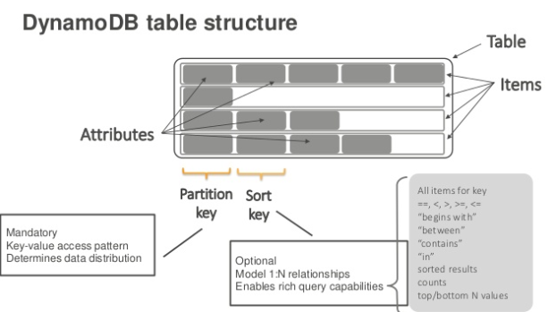
DynamoDB

Slide 38
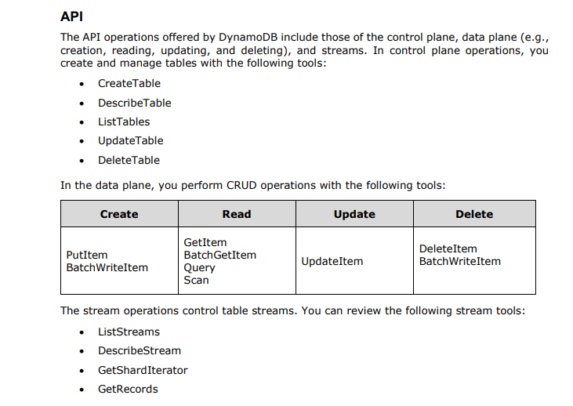
DynamoDB

Slide 39
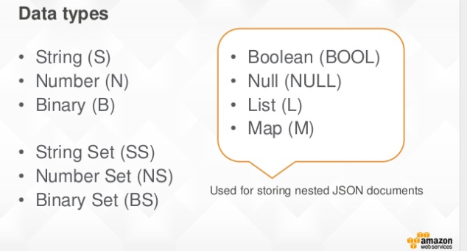
DynamoDB

Slide 40
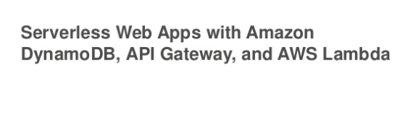
DynamoDB

Slide 41
Node.Js and DynamoDB
Prerequisites
Download and run DynamoDB on your computer.
Set up an AWS access key to use the AWS SDKs.
Set up the AWS SDK for JavaScript:
Go to http://nodejs.org and install Node.js.
Go to https://aws.amazon.com/sdk-for-node-js and install the AWS SDK for JavaScript.

Slide 42
DynamoDb RCU and WCU
For example, suppose that you create a provisioned table with 6 read capacity units and 6 write capacity units. With these settings, your application could do the following:
Perform strongly consistent reads of up to 24 KB per second (4 KB × 6 read capacity units).
Perform eventually consistent reads of up to 48 KB per second (twice as much read throughput).
Perform transactional read requests of up to 3 KB per second.
Write up to 6 KB per second (1 KB × 6 write capacity units).
Perform transactional write requests of up to 3 KB per second.

